Slide 1
Entity Framework Core
Enterprise & Mobile .NET

Slide 2
Entity Framework Core Intro

Slide 3
Entity Framework
Microsoft’s official data access technology for .NET development
Design & deploy on Windows, macOS & Linux
Notes:
Entity Framework Core, or EF Core, is an evolution of Microsoft's object relational mapper, which has been around since 2008 and evolving and improving dramatically over the years.
EF Core encompasses a set of .NET APIs for performing data access in your software, and it's the official data access platform from Microsoft.
It's used in millions of applications, and its cross‑platform.
You can build and run EF Core‑based APIs or applications on Windows, Mac OS, Linux, and even in Docker containers, whether on‑premises or in the cloud.

Slide 4
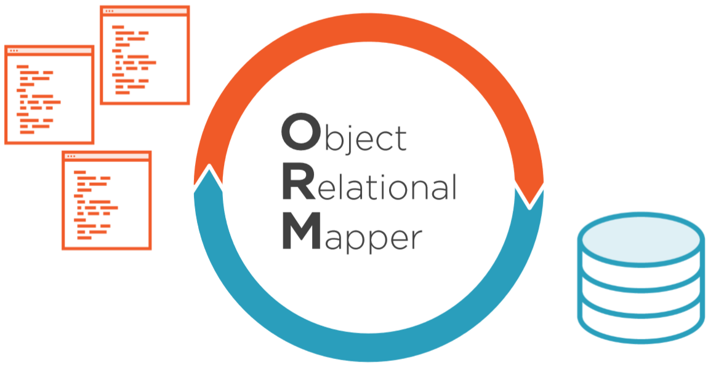
EF is an ORM
Notes:
Object relational mappers, or ORMs, are designed to reduce the friction between how data is structured in a relational database and how you define your classes.
Without an ORM, we typically have to write a lot of code to transform database results into instances of the types in our software.
An ORM allows us to express our queries using our classes, and then the ORM itself builds and executes the relevant SQL for us, as well as materializing objects from the data that came back from the database.
It also allows you to store, and update, and even delete data in the database.
Using an ORM can really eliminate a slew of redundant data interaction coding tasks.
In doing so, EF Core can really enhance developer productivity.
It also provides consistency in the tasks that it does, rather than having various members of your team invent their own means of designing their data access.
While a typical ORM infers that the classes and database tables are of a similar structure, EF Core has a mapping layer in between, and that gives us a lot more flexibility in how to get from objects to tables and from object properties to table columns.
EF Core allows you to connect to a variety of data stores, mostly relational databases.
While Microsoft maintains rich providers for SQL Server and SQLite, and even an in‑memory provider that's incredible for automated testing, there are many other third‑party providers as well, some commercial and some from the community. One of the new features that came with EF Core 3 is support for a non‑relational database, Azure CosmosDB, Microsoft's document database that's in the cloud.
This allows you to leverage your existing knowledge of EF Core to interact with CosmosDB, instead of having to learn another client API.

Slide 5
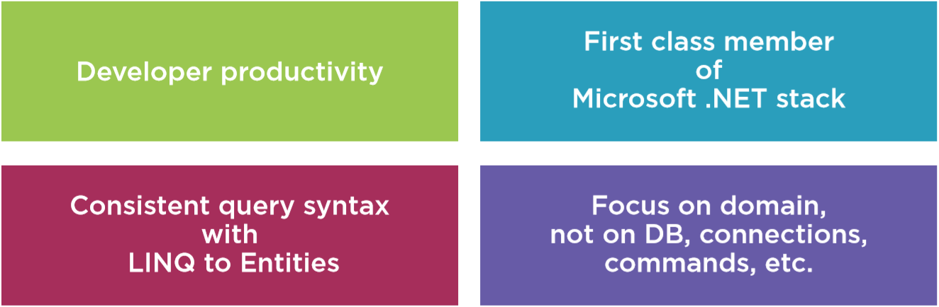
Why Entity Framework?
Notes:
So why an ORM over other ways of doing data access and why this ORM, why Entity Framework Core?
Using an ORM can really eliminate a slew of redundant data interaction coding tasks, and doing so, EF Core can really enhance developer productivity.
It also provides consistency in the tasks that it does, rather than having various members of your team invent their own means of designing their data access tasks.
Not to say that there isn't a learning curve for EF Core, especially if you want to leverage its advanced features, but in simpler scenarios, the learning curve can be quick.
EF Core has a dedicated team at Microsoft and Entity Framework has been around for over 10 years and has gone through a number of evolutionary steps as it gains functionality and has become more sophisticated.
The last version of what we might refer to as classic Entity Framework, and that's EF6, has over 14 million downloads.
It's used in myriad (large) applications and will continue to be supported and maintained, but the evolution to EF Core in order to continue to innovate on Entity Framework shows that this investment will continue to be of high importance to Microsoft.
Most ORMs allow you to connect to a variety of databases and EF Core is no exception.
While Microsoft maintains rich providers for a SQL Server and SQLite and even an in-memory provider that's incredible for automated testing, there are many other third-party providers as well, some commercial and some from the community.
Rather than writing the relevant SQL to target whatever relational database you're working with, EF Core uses the LINQ syntax that's part of the .NET Framework.
LINQ to Entities allows developers to use a consistent and strongly-typed query language regardless of which database they're targeting.
Additionally, LINQ for objects is used for querying other elements in .NET, even in-memory objects.
So developers benefit from their knowledge of LINQ whether they're using LINQ to Entities, LINQ to Objects, or some other flavor of LINQ.
Using an ORM allows developers to focus on their domain, their business rules, and their business objects, they don't have to worry about direct interaction with the database or being intimately familiar with the database schema. Developers still need to understand how Entity Framework Core works and some of its nuances with regards, for example, to tracking changes that need to be persisted to the database or patterns for working disconnected applications, but that follows the importance of understanding how any of your tools work and not just blindly using them in your software.

Slide 6
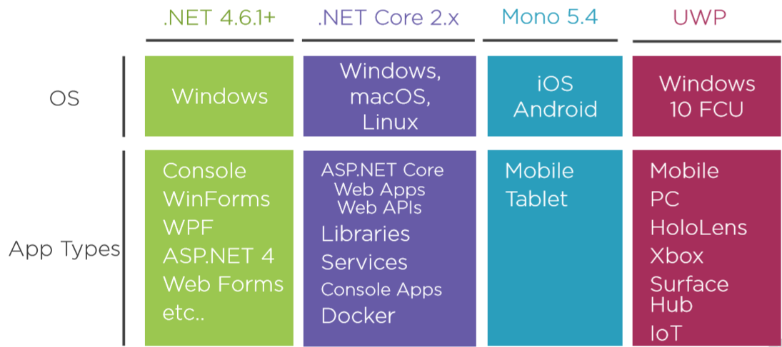
Application Types for EF Core
Notes:
EF Core is incredibly flexible with respect to where you can deploy it, as well as where you can build apps that use it.
EF Core runs on top of the Cross-platform .NET Standard 2.0, which is supported by a variety of runtimes from .NET Framework to Linux to UWP to iOS, but this means you can only build and run EF Core in apps whose runtime does sit on top of .NET Standard 2.
There has been a lot of confusion around this and I believe that many are still surprised that .NET Framework is one of those options and this doesn't just mean where you can deploy your apps, but also where you can build them.
Because .NET 4.6.1 and above supports .NET Standard 2.0, you can use EF Core in any of the classic Windows (WPF) or web applications.
That means you can benefit from features of EF Core without being forced to give up the application types your business and customers might still be relying on.
More obvious for EF Core is the fact that you can use it in .NET Core apps that run cross platform on Windows, Mac 0S, and Linux.
For Windows 10 Universal Windows Platform (UWP) apps, EF Core can run on any device that has Windows 10 Fall Creators update installed.
And Xamarin will let you use EF Core in native apps that run on iOS, Android, Windows, and Mac OS.
The requirements here are a little complicated because they differ from one environment to another.
In order to build anything with EF Core, you must have the .NET Core SDK installed on your machine.
If you're planning to build software that will only ever run on .NET Framework, you'll need to be on a Windows machine to do your development and you can use Visual Studio.
If you plan to build Cross-platform apps using .NET Core, you've got a lot of options, Visual Studio on Windows, Visual Studio for Mac, or the lightweight Cross-platform Visual Studio code, which you can use on Windows, Mac OS, or Linux, but there is still more.
If you're building mobile apps targeting UWP, your development machine must have Windows 10 Fall Creators Update on it and the latest version of Visual Studio is always best, but it has to be at least version 15.4.
And finally, building Xamarin apps also has a number of options, but the targets will determine your requirements.
Regardless of where you're doing the coding or where your application gets deployed, there is only one set of APIs that you'll use when working with EF Core.

Slide 7
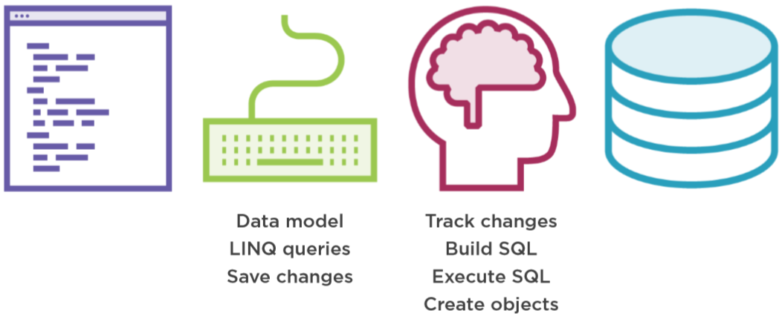
How EF Core works
Notes:
Here is a high-level look at EF Core's workflow which I feel is important to understand before jumping into any code.
The puzzle pieces involved fall into four different categories.
First, you need the classes that describe your domain, the business problem that your software is going to solve, and this part actually has nothing to do with Entity Framework.
Then you use Entity Framework APIs to define a data model based on those domain classes. You also use Entity Framework APIs to write and execute LINQ to Entities queries against those classes, and in your code, you'll need to call Entity Framework's save changes to push data back to the database.
What Entity Framework's APIs will do for you is keep track of the state of objects that it's aware of, it'll determine the SQL it needs to save data back to the database, and for queries, Entity Framework will transform your LINQ to Entities queries into SQL, execute that SQL, and then create objects from the query results.
The last major puzzle piece is that Entity Framework manages all of the interaction with the data store.

Slide 8
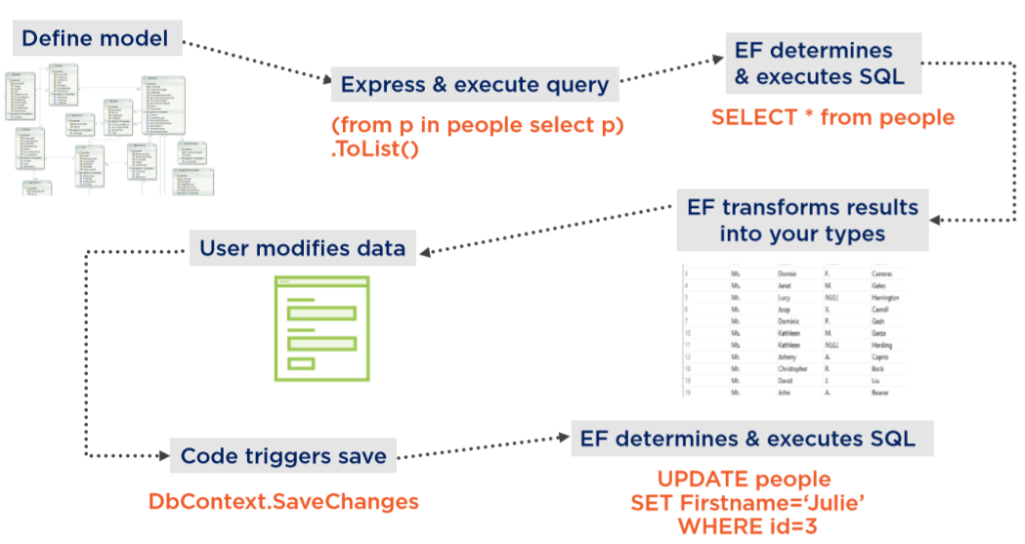
Basic Workflow
Notes:
With this information in hand, let's now look at a basic workflow of how Entity Framework works in an application.
As I said earlier, it all starts with your domain classes, not with Entity Framework, but with those classes, you can then use Entity Framework's DbContext API to wrap the classes into a model and instruct Entity Framework as to how those classes in the model map to the database schema.
With this understanding and the help of the relevant database provider, Entity Framework can then translate queries that you write in LINQ to entities against your classes into SQL that's understood by your database.
It then executes the query and uses the results to return populated instances of your objects, again, taking away all of that redundant work that we normally have to do.
You could also map to views, instead of tables, and if you need to, you can even execute stored procedures, maybe if Entity Framework just can't create efficiently performing SQL or if the query is just too hard to express with LINQ.
Entity Framework can keep track of objects as long as the DbContext is in scope, for example, this could happen in a desktop application. If you edit or add or delete an object, Entity Framework will be aware of it.
With disconnected apps though (e.g. a web application), we do have patterns to inform Entity Framework of this state of an object when it comes back from whatever was working with it.
Then with a single command, save changes, Entity Framework can use all that state information to build and execute the relevant insert, update, or delete commands on the database.

Slide 9
Creating a Data Model and Database with EF Core

Slide 10
Note: .NET Standard dependency
Open up console and type
dotnet --version
Installation instructions
http://microsoft.com/net/download
You need .NET Core SDK
Notes:
http://microsoft.com/net/download
Remember that EF Core has a dependency on .NET Standard 2.0, but that's not installed by Visual Studio 2019.
You can check to see if you've got the correct version using the command line.
First, type dotnet to see if dotnet is even installed. If it's there, then type dotnet --version and it will list the version of the dotnet command line interpreter or CLI.
If you need to install the latest version of the SDK, you can go to microsoft.com/net/download to get it.
The URL redirected to Windows because I'm on a Windows machine.
You'll be downloading the .NET Core SDK, which will also install the runtime for you.
Once that's installed, you can get to work in Visual Studio 2019.
Note: at this moment the latest version is of the .NET Core SDK is 3.1

Slide 11
Setting up the Solution
Pluralsight Demo
Start from blank solution without any projects
Add Projects
Class Library (.NET Standard) => Domain
Class Library (.NET Standard) => Infrastructure
Some UI Project (.NET Core Console)
…
It is a best practice to work with seperate projects for different layers of your application

Slide 12
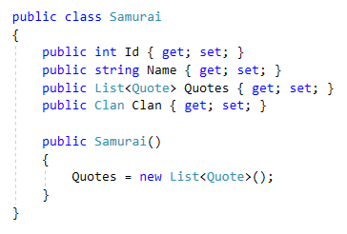
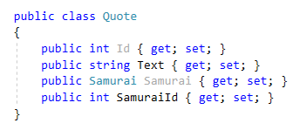
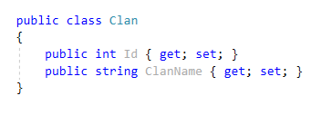
Model classes: Samurai, Quote, Clan
Notes:
The Samurai class has an Id property that will be used for the identifier.
It also has a name, a list of quotes, that would be famous quotes that the Samurai spoke in the movie.
I also have a Clan property that points to whatever clan the Samurai fights for.
The constructor ensures that the list of quotes is already instantiated before I try to use it in code.
The Quote class has an Id property for tracking it and a Text property that will contain the spoken quote.
I've also got a reference property back to Samurai and an explicit integer property that will contain the foreign key value, which is the Id of the Samurai.
The Clan class has an Id property and the name of the Clan.
So that's the starting point for my domain classes.
It's pretty simple, but I do have some relationships in here that we'll be working with, and that should suffice for working with the EF Core for the first time.

Slide 13
Adding EF Core
Pluralsight Demo
Use Nuget Package Manager
Install it to the “Infrastructure”-project
Install the latest “3.1” version (not version 5 or 6)
Search for microsoft.entityframeworkcore
Start with the package that holds the dataprovider for the datastore
E.g: Microsoft.EntityFrameworkCore.SqlServer
this brings all dependencies along
Package Manager Console
Notes:
In Package Manager Console, type:
install-package Microsoft.EntityFrameworkCore.SqlServer

Slide 14
Creating the Data Model with EF Core
Pluralsight Demo
Create a public class SamuraiContext
Inherits from DbContext
DbContext provides all the logic that EF uses to do change tracking and DB interaction
Create DBSet-props for all types that you need to interact with
Add a reference to the Domain-project
Notes:
Now that Entity Framework Core is in the data project, I can go ahead and build a data model to drive the persistence of my domain classes into the SQL Server database that I'll be using.
I'll create a new class file and name it SamuraiContext because it will be using EF Core's DBContext class.
My class needs to be public and to inherit from EF Core's DBContext.
The DBContext will provide all of the logic that EF Core is going to be using to do it's change tracking and data base interaction tasks.
A DBContext needs to expose DbSets, which become wrappers to the different types that you'll interact with while you're using the context.

Slide 15
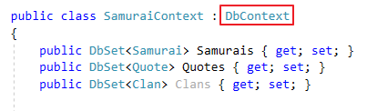
SamuraiContext
Notes:
The first DbSet that I want to create is the DbSet of Samurai type, and I'll call that Samurais.
The data project does need a reference to the domain project, so it can find the Samurai and the other domain classes.
Now I'll add in DbSets for the quote and for the clan.
How do you define your DBContext is important to how EF Core treats your data at runtime, as well as how it's able to interact with your database, and it can define how you use the model in your coding.
Because I've exposed all three of these DbSets, I'll be able to directly query the Samurais, or the Quotes, or the Clans.
EF Core also comprehends the relationships that it discovers in the entity classes that we've just made it aware of.
And based on what the DBContext will discover from these classes, it will use its own conventions for how to infer the relationships.
It will see that there's a one‑to‑many relationship between Samurai and Quote, and that there's a relationship between Samurai and Clan, where any number of Samurais can belong to a single Clan.
The DBContext also affects how EF Core infers the database schema, whether you're working with an existing database or you're going to let EF Core create the database using this model.
For example, EF Core will presume that the table names match these DbSet names.
There's a lot you can do to affect how EF Core infers that model at runtime as it reads the DBContext and any other information you might provide.
But for now, I'll just stick with EF Core's defaults, given that I've already made it aware of the Samurai's, the Quotes, and the Clans.
Further on in this course, I'll spend some time providing you with more information about defining the DBContext.
I'll give you some tips and tricks on taking more control over how EF Core interprets your data model by way of this context.

Slide 16
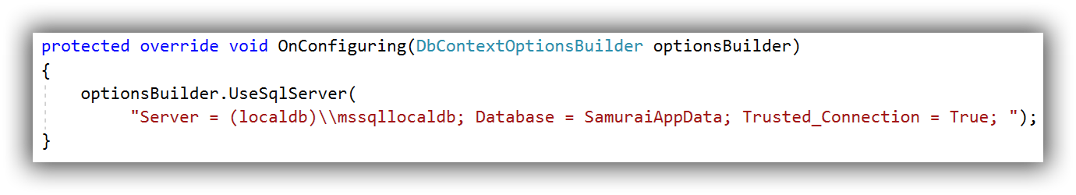
Specifying Data Provider and Connection String
Pluralsight Demo
DbContext must know what data provider and connection string to use
Hard-coded in OnConfiguring method (Ok for demo purposes)
Or inject this information (DbContextOptions) in the constructor (out of scope for this course)
Notes:
Even though you've already seen me bring EF Core's SQL Server provider into this project, my DbContext is still completely unaware of that provider.
With EF Core, you need to explicitly tell the context what data provider to use and explicitly give it a connection string.
There are a few ways to do this.
One is directly in the DbContext class, and that's what I'll do here. Now, hard coding the connection string into the context is great for demos and first looks, but not for your real software.
Later, you'll see me take advantage of some features of ASP.NET Core to inject this information into a DbContext at runtime.
In EF Core, the DbContext has a virtual method called OnConfiguring.
I'll add that into my class using the override snippet.
OnConfiguring will get called internally by EF Core as it's working out what goes in the model, and it will also pass in an optionsBuilder object.
You can use that optionsBuilder to configure options for the DbContext.
Notice that the optionsBuilder has a method called UseSqlServer.
That's an extension method, and it's available because I've got a reference to the Microsoft Entity Framework Core's SQL Server API.
If I had pulled in SQLite, I would see a method called UseSqLite here.
So I'll choose the UseSqlServer method, which expects a parameter, that's the connection string.
And this is how, in a single statement, I can tell the DbContext: “hey, you're going to be working with SQL Server and here's the connection string to the database that I want you to use”.
Now in my case, the database doesn't exist yet, but there are a number of ways to let EF Core help you create a database.
And that's possible because EF Core is able to read the model that this DbContext describes based on the classes that it's pointing to.
And it can do it on the fly, at runtime, or you can explicitly do this at design time, and you even have the option of letting it create the database directly or just having it create SQL scripts.
The first time EF Core instantiates the SamuraiContext at runtime, it will trigger the OnConfiguring method, learn that it should be using the SQL Server provider, and at the same time, be aware of the connection string.
So that way it will be able to find the database and do its work.

Slide 17
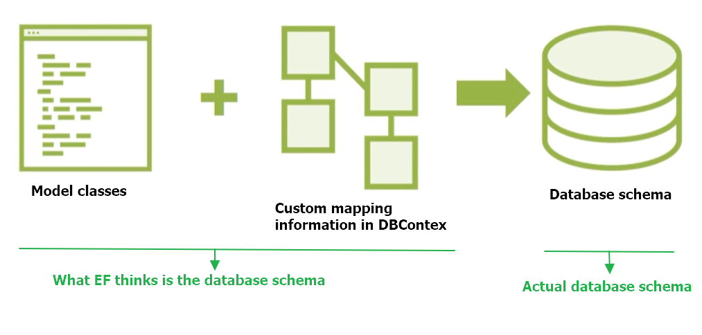
Mapping data model to database
Notes:
If you've never used Entity Framework migrations before, it's important to understand the basics of what this feature does and it's workflow before interacting with the APIs.
Here, I'll provide a quick overview. Entity
Framework needs to be able to comprehend
how to build queries that work with your database schema
how to reshape data that's returned from the database in order to create your objects from them
as you modify the data, how to get that data into the database.
=> See basic workflow slide
In order to do that, it has a comprehension about how the data model you've defined through DBContext maps to the schema of the database.
It performs that logic at runtime by reading the DBContext and using its own conventions, combined with any additional custom mapping information that you've provided to it to infer the schema of the database.
And with that information, it's able to figure out how to do those interactions, how to build queries, how to construct commands to push data to the database, and how to transform database results into your objects.
That also means if you evolve your data model, and that could be because you've made changes to the structure of your classes, or you've added more information to the DBContext, then Entity Framework's comprehension of the database schema will also change.
But that's just what Entity Framework thinks is in the database, so it's important to make sure that what it thinks the database look like is actually what the database looks like.

Slide 18
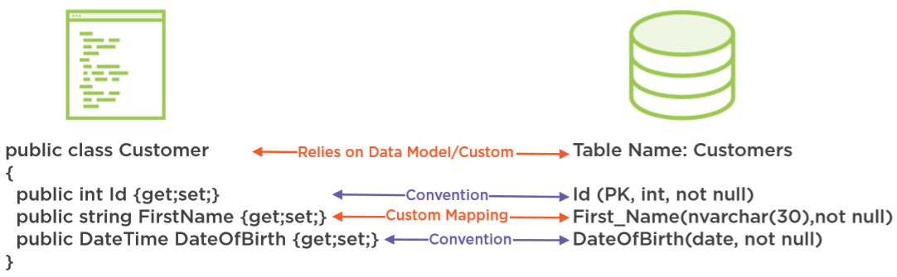
Mapping Classes & Properties to Database
Notes:
When defining the data model, your classes aren't required to exactly match the schema of the database.
Entity Framework does have a lot of default rules for how it will infer what the database schema looks like and that helps it determine what the SQL should be for commands and queries and also how to create objects from query results coming back from the database.
For example, it presumes that property names match the column names in the map table, it also makes presumptions about types in many other facets, but you can affect most of the mappings, for example, a custom mapping is helping Entity Framework understand that the FirstName property doesn't follow convention when it maps to the database, but instead, should map to a column named First_Name that's an nvarchar with a length of 30 and that it's not nullable.
I'll also take advantage of an EF core convention when it is on my context. That's one that ensures Entity Framework will understand that the name of the table I'm mapping to is plural. But keep in mind, these are facets of the database schema and they don't, by default, drive the business logic and validations in your code.

Slide 19
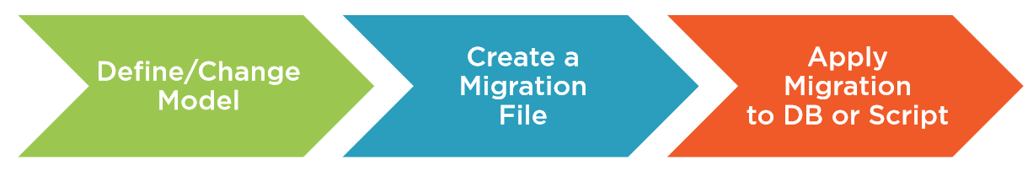
EF Core Migrations
Notes:
Along with a Code First paradigm, with the Entity Framework and Entity Framework Core, we also have a full set of APIs referred to as migrations.
With each change to your model, you can create a new migration that describes the change, and then let the migrations API create the proper SQL script.
If you would like, the migrations API can also execute that script for you right on the database.
One last point, an important one that I want to make about migrations in the EF Core, is that they're designed to work easily with source control on your team.
And this is a big change that EF Core brought over earlier versions of Entity Framework. You'll see more about that as we move forward.

Slide 20
Adding your first migration
Pluralsight Demo
Add Nuget Package to the executable project (UI)
Microsoft.EntityFrameworkCore.Tools
Set as StartUp project
Package manager console
Default Project should be the Infrastructure-Project
Get-Help EntityFramework
Commands
Add-Migration
Checks the data model for changes and creates a file with the information needed to create or migrate the database
Update-Database
Applies a migration to the database
…
Notes:
It's time to create the first migration for the Samurai context, and here we're going to take advantage of the ConsoleApp (UI).
The migrations tools need some type of executable to help them run, so the infrastructure library project won't be able to do that on its own.
In order to create and execute migrations, we'll need access to the migrations commands and to the migrations logic.
Not every developer working with EF Core is going to create and execute migrations, so those are in separate packages.
The commands are in a package called Microsoft.EntityFrameworkCore.Tools, which you can install using the NuGet Package Manager just like I did with the other packages.
Remember, you need to add that to an executable project.
So in my solution, that's the console project.
You'll run the commands in the Package Manager console, which is for executing PowerShell commands.
Because EF Core and the commands and the context are in the SamuraiApp.Infrastructure project, you have to be sure that the console's default project is pointed to that.
Let's take a look at what the PowerShell commands are for EF Core.
I can do that by typing get‑help entityframework.
You can see that the commands are
Add‑Migration
Drop‑Database
Get‑DbContext
Remove‑Migration
Scaffold‑DbContext
Script‑DbContext
Script‑Migration
Update‑Database.
Add‑Migration will look at the DbContext and determine the data model.
Using that knowledge, it will create a new migration file with the information needed to create or migrate the database to match the model.
Update‑Database applies the migration to the database.
Since the task right now is to add a new migration, I won't delve further into the other commands, and we'll just focus on adding migration and updating the database.
Add‑Migration has a number of parameters, but I'm only going to use the required parameter, the name of the migration file I'm creating.
And you can see right away I get an error message.
The error says that the startup project, which currently happens to be SamuraiApp.Infrastructure, targets NETStandard but needs a runtime in order to execute the command.
I need to make sure the startup project and the solution are set to the ConsoleApp.
After making that change, I can go back to the console with a default project still pointed to infrastructure since that's where the migrations need to go, and I can run the Add‑Migration command again, and this time it succeeds.

Slide 21
Inspecting your first migration
Pluralsight Demo
New Folder Migrations in the Infrastructure Project
Xxxxx_init.cs => info to build the database
XXxxxx_Snapshot => version info of the current database/model
Notes:
Let's take a look at the migration I just created.
Notice that there is a new Migrations folder in the infrastructure project, and in there is the new migration file called init along with a timestamp.
There is another file in there called model snapshot and that's where Entity Framework Migrations keeps track of the current state of the model and that's really important because next time you add a migration, EF Core will read that snapshot, compare it to the new version of the model, and that's how it figures out what needs to be changed in the schema.
The snapshot is just a file, it's part of the project, and it can participate fully in source control when you're using EF Core and Migrations across members of your team.
If you're coming from a previous version of Entity Framework and you're on a team that's using migrations, this is probably cause for celebration. This is a really important improvement that we got with EF Core.
The migration uses EF Core's Migration API to describe what needs to happen in the database, and notice the annotation in the generated file that specifically says SqlServer:ValueGenerationStrategy.
That's because migrations read the configuration information that we supplied in the SamuraiContext and knew that we're targeting SQL Server and so it interacted with the SQL Server provider to determine some important metadata.
Scrolling through the migration file, you can see that it's creating tables, and for the tables, it's creating the columns along with particular attributes for those columns.
Also, notice that it's specifying primary keys and foreign keys, as well as constraints between those primary and foreign keys.
It even specified a few indexes and EF Core's conventional rule behind indexes is to create an index for every one of the foreign keys that it discovers in the model.
All of that is part of a method called Up and here is another method called Down, that's used if we ever want to unwind this particular migration.
So that's it for this first migration. The next step will be to have the migration tools create the database.

Slide 22
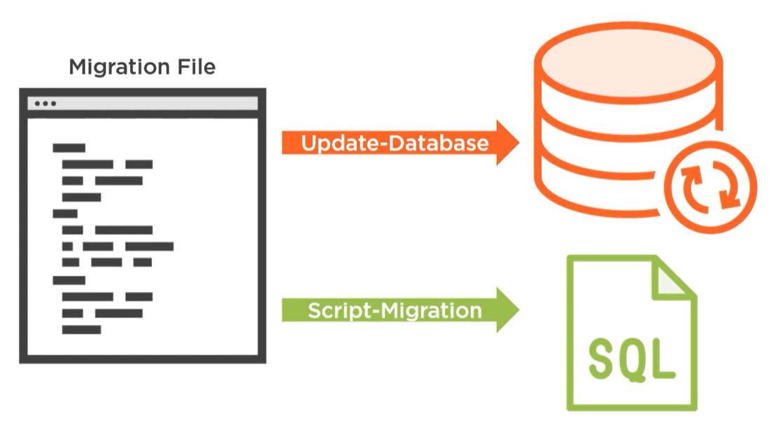
Apply a migration
Pluralsight Demo
Script-Migration => T-SQL script
Update-Database => Directly create database
verbose => informative output
Notes:
With the migration in place, we now have everything we need in order to create a database.
Not only do migrations give me the ability to have Entity Framework create the database for me directly, I can also have it generate a script, which is an important feature for working with a production database or sharing your development database changes with your team.
EF Core's script‑migration command will build up the relevant SQL.
In this case, it's T‑SQL because I'm using SQL Server based on what is discovered in the migration file.
Now with this T‑SQL in hand, you can let your resident database expert take care of executing it on the production database.
They may even want to make some tweaks to it.
With my development database, I'll typically let migrations go ahead and create and update the database for me on the fly.
But with a production database, a more common scenario is to take advantage of the ability to generate the SQL and taking more control over how and when it's applied to the production database.
Alternatively, you can let EF Core migrations directly affect the database with the update‑database command.
Before I run that, I do need to point out that I deleted the database, which was created by EnsureCreated in the previous module.
So now the database does not exist at all. In fact, if we look back at the migration, there's nothing in there that says create the database.
That's actually handled by the internal code inside of migrations, which first checks to see if the database exists or not before the migration's run.
If it doesn't exist, then EF Core will first create that database at the given location.
If you've created a script and you're running that, you will be responsible for creating the database yourself.
I won't be using any of the update‑database parameters, although I will use a parameter that's common across PowerShell, which is the -verbose parameter.
This lets you see everything that the update‑database command is doing, and you can see it's discovering the correct projects, it's rebuilding the solution, and then finding all of its assets.
Finally, it applies the migration, and it's done.
Now, after I refresh the SQL Server Object Explorer, you can see the new database, SamuraiAppData, and if I expand that further, you can see the new tables: Clans, Quotes, and Samurais.
Those pluralized names were driven by the way I named the DbSets in my DbContext.
So what about that history table?
Its job is to keep track of which migrations have been run on the database, and its columns are MigrationId and the ProductVersion that was used.
Let’s look at the tables from a different perspective by looking at the database schema (using SQL Server Object explorer or SQL Server Management Studio).
You can see that it created primary keys, and that's thanks to one of EF Core's conventions based on the fact that the property names in my classes were named Id.
You can also see that the default data type derived from my string properties is an nvarchar(MAX), which is actually a default that's driven by the database provider, not by EF Core.
We saw in the migration code that it was working out not just the primary keys, but also foreign keys.
And you can see those relationships in the database schema along with the names that EF Core's conventions provided for those constraints.

Slide 23
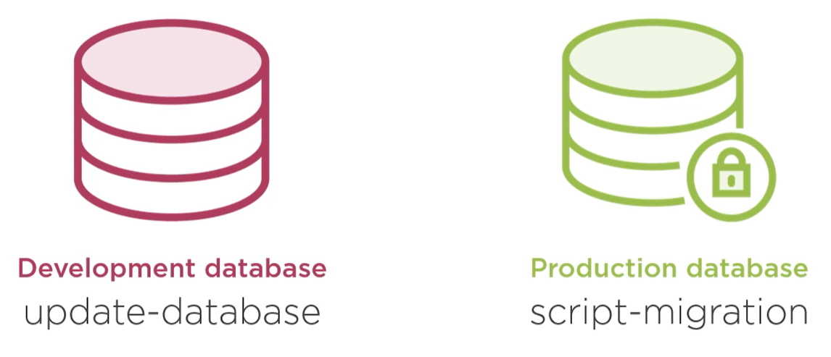
Migration recommendation

Slide 24
Reverse engineering an existing database
Pluralsight Demo
Powershell command: scaffold-dbcontext
provider (e.g. Microsoft.EntityFrameworkCore.SqlServer)
connection (e.g. “Data Source=(localdb)\MSSQLLocalDB; Intitial Catalog=SamuraiAppData”)
Article: How to use EF migrations with existing database schema and data
Notes:
Article: How to use EF migrations with existing database schema and data

Slide 25
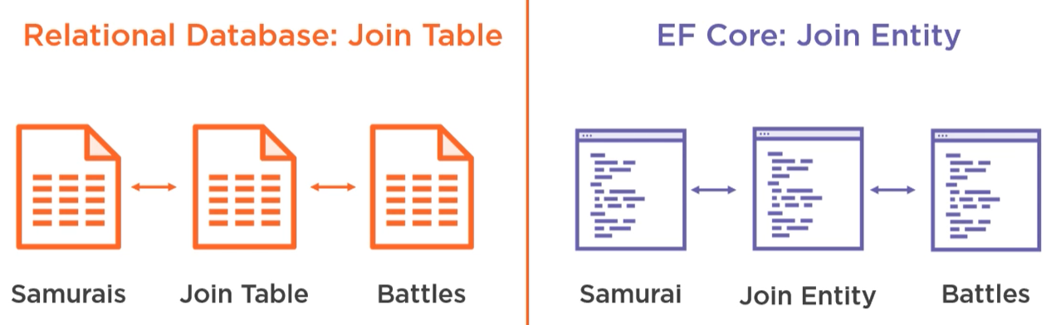
Many-to-many relationship
Pluralsight Demo
Must use a join entity that can be mapped on a database join table
Notes:
It's important to understand how many‑to‑many relationships work in EF Core, and also why.
One of the big jobs of a samurai is to fight in battles, so I'll be adding a new battle class into the domain in order to keep track of information about the battle.
And then we'll need to introduce a many‑to‑many relationship between samurai and battle.
That will let us keep track of all the battles the samurai fought in and all the samurais that fought in a particular battle.
In EF Core you have to represent a many‑to‑many relationship explicitly with a join entity.
This aligns with how it's done in a relational database.
There are pros and cons in using a join entity:
When defining my business objects, I do want to be able to easily navigate from a samurai to all the battles which the samurai's fought in, and I would like to easily be able to look at a battle, and then see all of the samurais that fought in a particular battle. Even if I design my entity classes this way, EF Core isn't able to recognize this pattern in order to persist the data. And because we have to put that join entity in between, it does create some complications for us in how we interact with that data in our code. So from that perspective, being forced to use the join entity does present a problem;
However, here's another perspective. I don't like a lot of magic to happen that I can't control. EF would need to do some tricky transformations behind the scenes in order to persist many‑to‑many relationships to the database. That's fine when things are simple, but when you run into complications, it's a little more difficult to sort out because you're not in control of how it works.
For this course, it's best to take the simple path and follow the pattern prescribed by the EF team, which is to implement the join entity.
And later in the course, you'll see how to interact with these classes, including the join entity, when retrieving and saving your data.

Slide 26
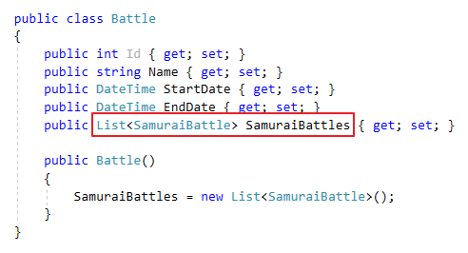
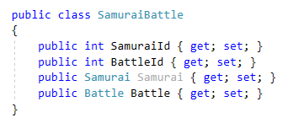
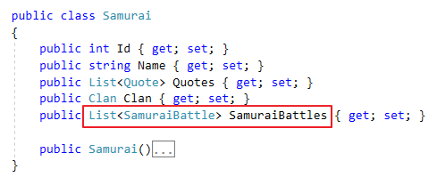
Many-to-many - Join Entity
Notes:
Let’s take a closer look at the new classes.
The Battle class got its Id, the Name of the battle, and its StartDate and EndDate.
In addition to the new Battle class, I've created the join entity class named SamuraiBattle.
This has a SamuraiId and a BattleId property, and these are required because they'll become foreign keys pointing back to the Samurai class and the Battle class.
I've also added navigation properties to Samurai and Battle, but these are optional.
Whether or not you need them depends on how you plan to interact with these objects in your business logic, but they're not needed by EF Core in order to comprehend the model and how to persist it.
Next, I need a list of SamuraiBattles in the Samurai class, and we'll need to instantiate that in the constructor, so you don't run into any surprises because of it being null.
And we also need to add the SamuraiBattles list into the Battle class and instantiate in its constructor as well.
And with those, it's now possible for a Samurai to have many SamuraiBattles, which will connect it to any of the battles that those lead me to.
In the Battle class, the SamuraiBattles list will connect the battle back to the Samurai represented in each of those connections.
The classes involved in the many‑to‑many are now set up properly, but EF Core can't infer this relationship on its own…

Slide 27
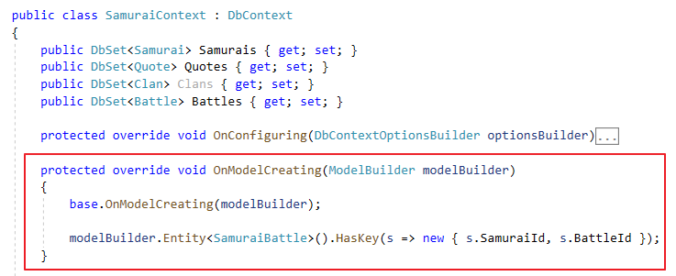
Many-to-many - DbContext
Notes:
We have to give EF Core some more information so that it can map to the database, as well as translate queries and updates.
Here in the SamuraiContext class, I'm using the Fluent API to specify the last critical detail of the many‑to‑many relationship.
The place to add custom mappings (from data model to database schema) is in het DBContext's onModelCreating method.
This method gets called internally at runtime when EF Core is working out what the data model looks like.
Using the modelBuilder object that EF Core has passed into the method, I've told it that the SamuraiBattle Entity has a key that's composed from its SamuraiId and BattleId properties.
Now EF Core will be able to understand the database schema that's related to this, as well as to build the SQL for queries and database updates that respect this many‑to‑many relationship.
Fluent API reference:
https://www.learnentityframeworkcore.com/configuration/fluent-api

Slide 28
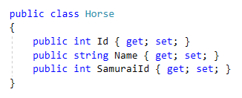
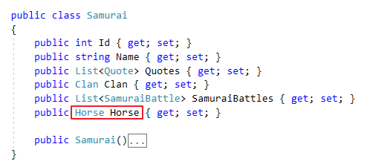
One-To-One relationship
Samurai <-> Horse
A samurai can have one trusty steed
Notes:
Now let's move on to the one‑to‑one relationship.
I've created a new class called Horse to keep track of each samurai's trusty steed.
The new class has an Id, the horse's name, and the Id of the samurai that it belongs to.
The Samurai class now has a navigation property to define the samurai's horse.
With the navigation property in Samurai and the foreign key in the Horse class, it's enough for EF Core to comprehend the relationship without any more information from me.

Slide 29

One-To-One relationship
Notes:
Keep in mind that the dependent end of a one‑to‑one relationship, in this case the horse, is always optional as far as EF Core is concerned.
There's no way to apply that constraint in the model or, for that matter, in the database.
If you want to require that samurai always has a horse, you'll have to do that in your business logic.
But I'll keep that simple, and we just might have to have some samurais that have to walk.

Slide 30
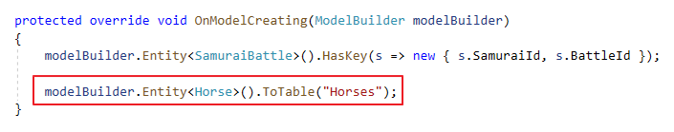
Controlling table names
Pluralsight Demo
Add DbSet<Battle> to DbContext
Now it will be possible to interact directly with battles in the code
EF will infer the table name “Battles” from the name of the DbSet property
No need to add a DbSet<Horse>
EF will infer the relation via the Samurai class
EF will infer the table name “Horse” from the name of the class => Use Fluent Api to change it to “Horses”
Notes:
There is one last change to make, and that's in the DbContext.
Further on in the course, I want to be able to interact directly with battles through the DbContext, so I've added a new DbSet called Battles.
EF Core will also be able to find the Horse class because it's connected to the Samurai.
However, by default, EF Core will create a table name that matches the name of the class since I haven't specified a DbSet.
And that's going to be singular, horse, which doesn't align with my convention for table names.
But I don't want to add a DbSet just for that reason because then someone working with my API might be tempted to interact directly with horses, which doesn't align with my business rules.
There is another way to affect the table name, and this is another great example of how flexible the mappings are.
I can use the fluent API or data annotations to change that.
So in OnModelCreating, I've added a line of code to tell the modelBuilder that the Horse entity maps to a table called Horses, and I'm using the ToTable method to do that.

Slide 31
Add a second migration
Pluralsight course
Data model has new classes and relations
Database schema is not in sync with the model
Add-migration
Update-database

Slide 32
Fluent API
Helps EF to build the model and its database mappings
Docs: https://www.learnentityframeworkcore.com/configuration/fluent-api
Configure entities (tables): https://www.learnentityframeworkcore.com/configuration/fluent-api/type-configuration
Configure properties (colums): https://www.learnentityframeworkcore.com/configuration/fluent-api/property-configuration
Notes:
Configurations are applied via a number of methods exposed by the Microsoft.EntityFrameworkCore.ModelBuilder class.
The DbContext class has a method called OnModelCreating that takes an instance of ModelBuilder as a parameter.
This method is called by the framework when your context is first created to build the model and its mappings in memory.
You can override this method to add your own configurations
Docs: https://www.learnentityframeworkcore.com/configuration/fluent-api
Configure entities (tables): https://www.learnentityframeworkcore.com/configuration/fluent-api/type-configuration
Configure properties (colums): https://www.learnentityframeworkcore.com/configuration/fluent-api/property-configuration

Slide 33
Data Seeding
Provide initial data to populate a database
It is part of the model configuration
EF Core migrations compute automatically what insert/update/delete operations are needed
Use HasData-method on Entity class
Notes:
https://docs.microsoft.com/en-us/ef/core/modeling/data-seeding
This feature is available since EF Core 2.1

Slide 34
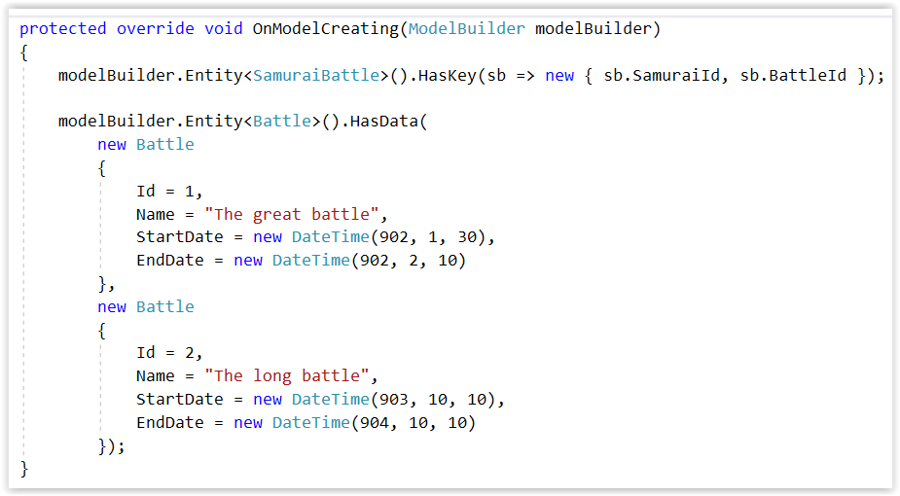
Data Seeding
Notes:
With HasData you configure entities with data. Then you perform a new migration to add these to the migration code:
Add-Migration battledata
Update-Database triggers migrations and therefore creates the necessary data.

Slide 35
References

Slide 36
Pluralsight
Entity Framework Core: Getting Started
Course overview
Creating your first app using EF Core 3.1
Controlling database creation and schema changes
Mapping many-to-many and one-to-one relationships
Notes:
Pluralsight Course: Entity Framework Core: Getting Started

Slide 37
Need to dig deeper?
Recommended:
Read the official Microsoft documentation when you want to have a deeper understanding of a concept
https://docs.microsoft.com/ef/core
Notes:
https://docs.microsoft.com/ef/core

Slide 38
Gotcha

Slide 39
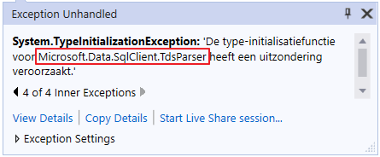
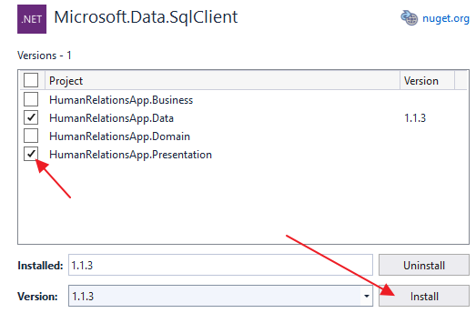
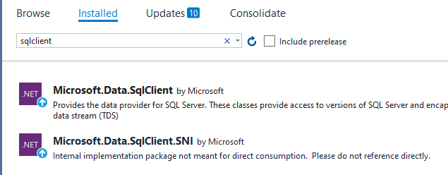
EF Core – Migrations in .NET 4.7
When the executable project is a classic .NET 4.7 project (e.g. a WPF project) an exception might occur when applying a migration (e.g. with ‘update-database’
Microsoft.Data.SqlClient.TdsParser
Fix:
Find the ‘Microsoft.Data.SqlClient’ package in the installed packages of the solution
(Also) add the package to the executable project
Alternative Fix:
Add the whole Microsoft.EntityFrameworkCore.SqlServer package to the executable project
Notes:
Pluralsight Course: Entity Framework Core: Getting Started

